Slide 1
‘Busy’ Record, Put-callback Support
Kay Kasemir
Oct. 2018

Slide 2
Basic Automation Problem
Has the motor reached the position?
Move motor to some position
Open shutter
Take data for 5 seconds
Close shutter
How long does the shutter need to open?

Slide 3
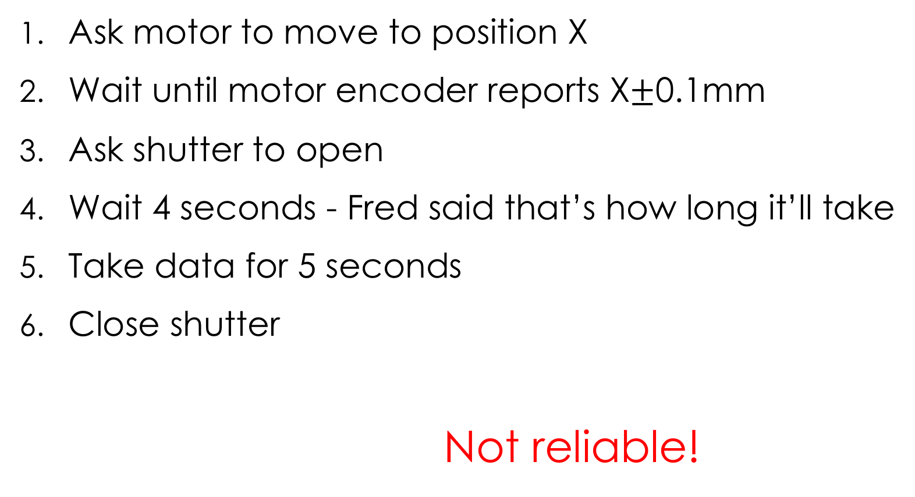
What not to do
Ask motor to move to position X
Wait until motor encoder reports X$±$0.1mm
Ask shutter to open
Wait 4 seconds - Fred said that’s how long it’ll take
Take data for 5 seconds
Close shutter
Not reliable!

Slide 4
Based on readback, are we done?
Temp,
pos,
…
Setpoint
Readback
done?
done?
done!
Time

Slide 5
IOC has to tell us when it’s done
Use CA “put-callback”
Record completes callback when its “done”
Requires record with completion support
Motor record: When reaching desired position
General record: Check device support manual
Plain database: Use BUSY record

Slide 6
EPICS record PACT field
PACT is binary flag that is 1 (ON) when record is processing
put-callback is mechanism to use PACT information…
…and not return until PACT is 0 (OFF)
But it only works with CA
caput -c -w <timeout> <PV>

Slide 7
BUSY record
VAL = 0 “Done” or 1 ”Busy”
Blocks processing (PACT=1) while busy
Record A
Busy record
VAL=1
Record B
caput –c …
write
Link
Link
Record A
Busy record
VAL=0
Record C
done
Link
Link
caput –c …

Slide 8
Typical Use
Writing to some record, which has FLNK or OUT links to a busy record, sets the busy.VAL = 1
This causes writer to that first record to block in put-callback
Something else resets busy.VAL = 0
  Other database logic
  Sequencer code
  asyn device support
  …
Put-callback completes

Slide 9
Example
record(ao, "SetPoint") {
field(FLNK, "BusySet")
}
record(ai, "ReadBack") {
field(FLNK, "BusyClear")
}
record(longout, "BusySet") {
field(VAL, "1")
field(OUT, "Busy PP")
}
record(longout, "BusyClear") {
field(VAL, "0")
field(OUT, "Busy PP")
}
record(busy, "Busy") {
}

Slide 10
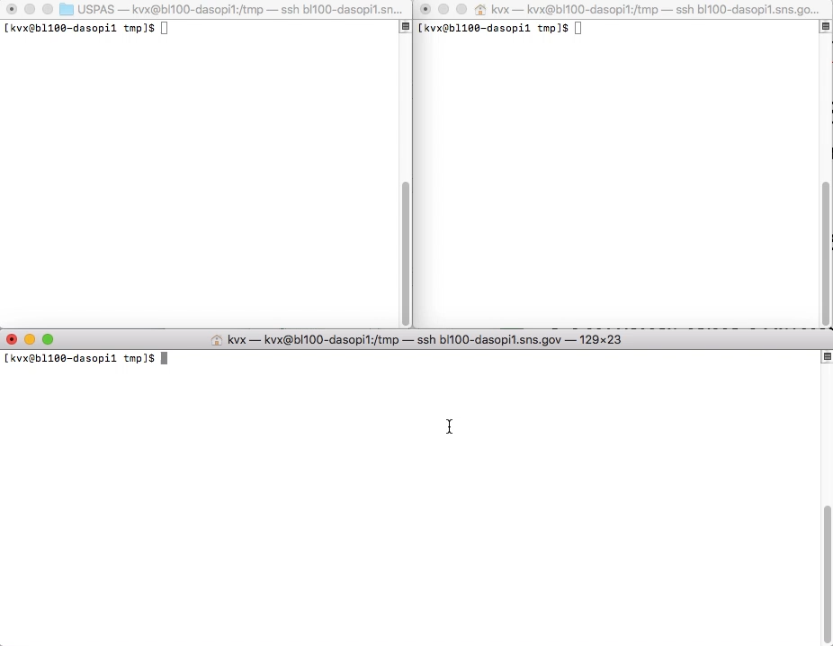
Example

Slide 11
Put-Callback
.. Is essential for robust automation
Use BUSY record to create database logic that supports put-callback

